Slide 1

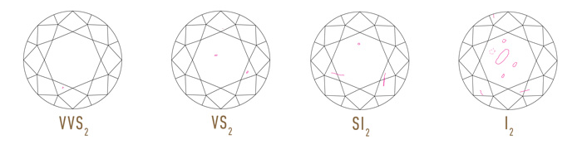
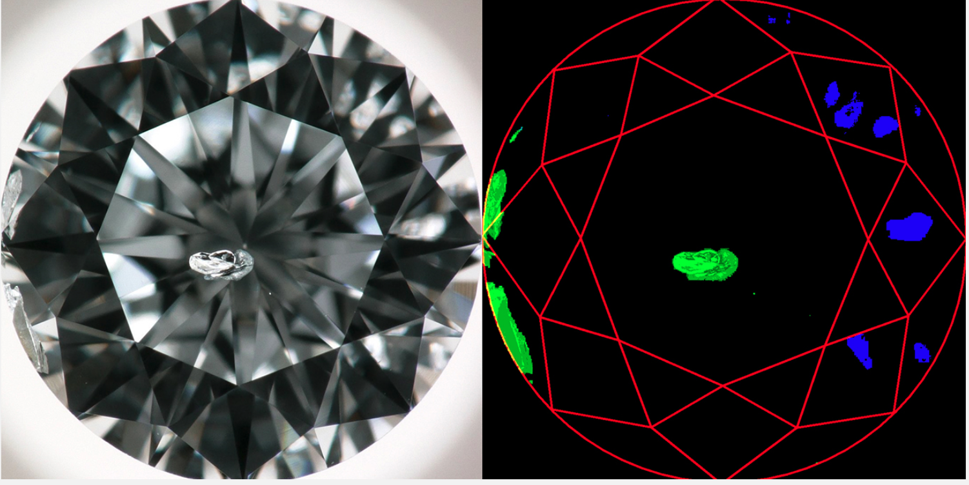
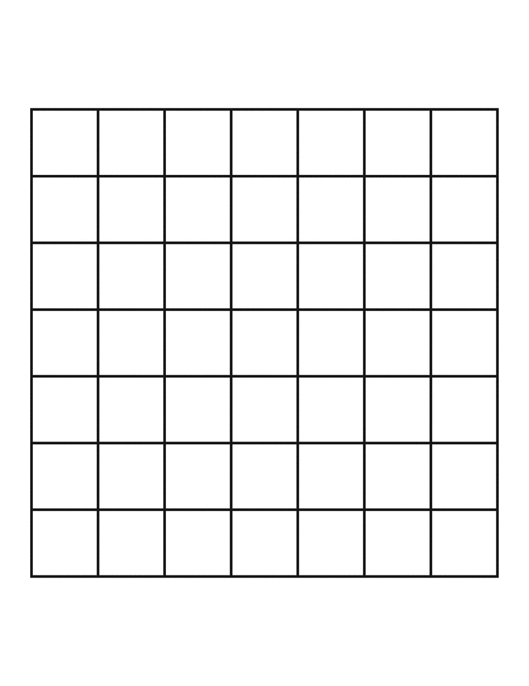
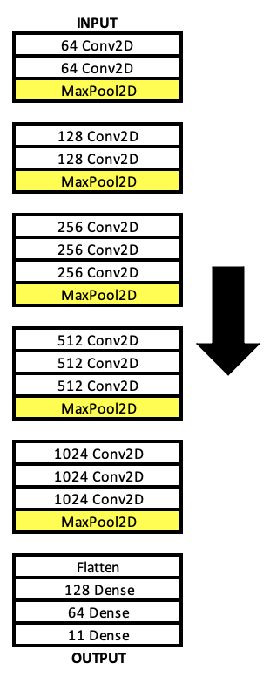
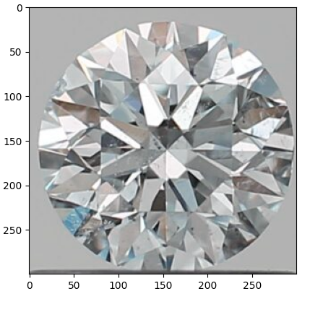
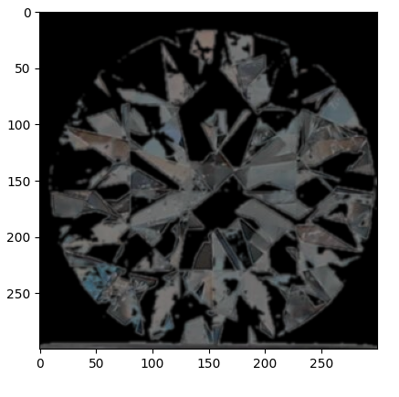
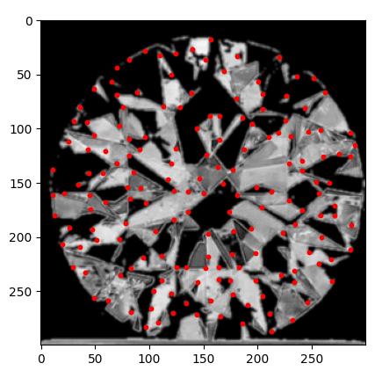

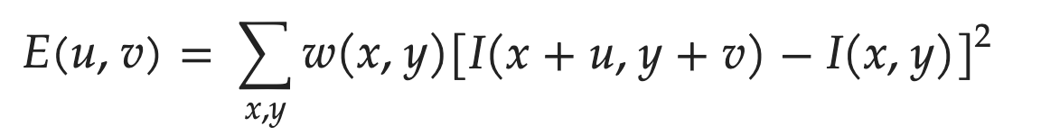
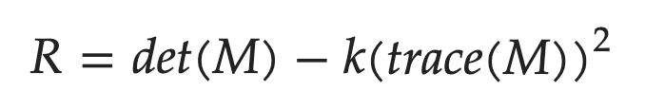
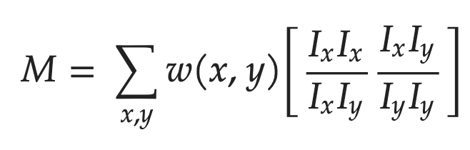
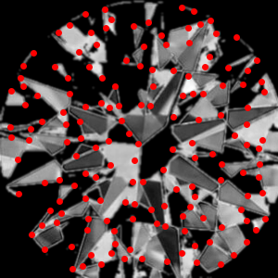
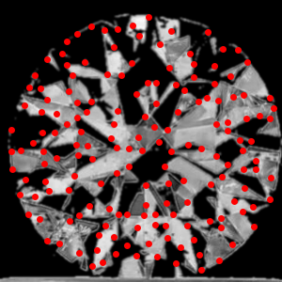
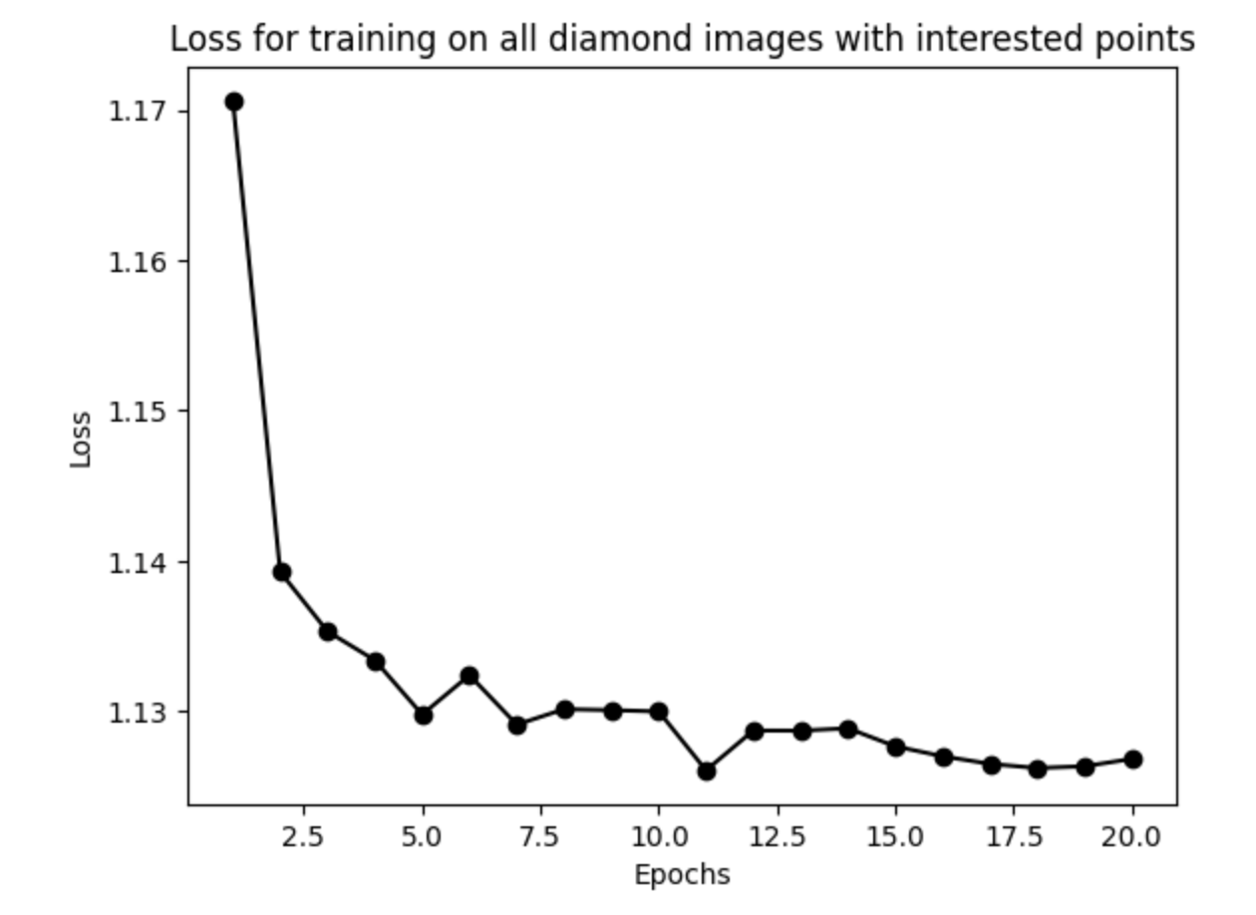
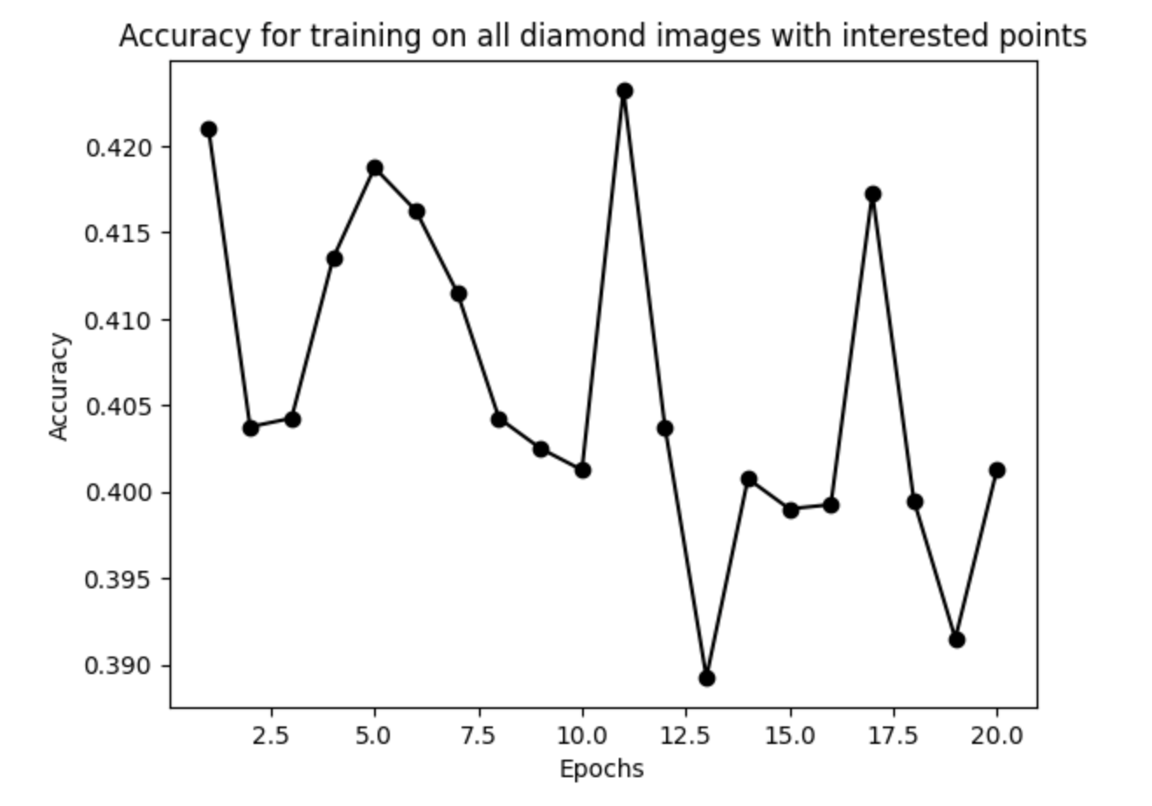
Shine Bright Like a Diamond
Bryce Jones Nicholas Fah-Sang Suyash Kothari Zhirui Li
Motivation
Define the problem
Goal
Grading diamonds by clarity–the quality of a diamond, which is determined by its lack of inclusions or imperfections–is typically an intensive process of the diamond supply chain, unlike cut, color and carat, which are the other metrics used to determine a diamond’s price and use case. This is because it has historically relied upon human graders and expensive machinery. Inspired by the ongoing area of research conducted by the GIA-IBM partnership to automate diamond grading by clarity, we decided to attempt clarity grading using both conventional image processing techniques and also more modern deep learning techniques learned in class.
The GIA scale for diamond clarity is based on the number of inclusions that can be observed at 10x magnification. The grades are FL (Flawless), IF (Internally Flawless), VVS (Very Very Slightly Included), SI (Slightly Included) and I (Included).
Use traditional CV strategies to extract inclusions
Create a neural network that consistently correctly classifies images of diamonds based on clarity
[1]
What is the insight into the problem that leads to the solution?
More details. Explain how it works.
Classical methods: Reflections and facets are structurally different from inclusions. Specifically, regions of reflection contain a small number of variations in intensity in all directions, whereas regions of inclusions contain a large number of variations in intensity [2].
DL methods
VGGs are designed for complex classification problems, thus this is a good use case for them. The threat of overfitting can be mitigated by dropout layers.
Input: Diamond Image
*
R[]
*
Sobel
I_x, I_y
*
Gaussian
*
Find Maxima
List of intersections
This is used to find partial derivatives of intensity
I_xx, I_xy, I_yx, I_yy
*
Provide concise and precise information at low density.
Intersections
Shifted Intensity
DL Model
Equation (1)
Intensity
Gaussian Window
Background Removal
Classical CV algorithm to find ‘intersections’
Equation (2)
Equation (3)
Partial Derivatives
Results (images/figures)
More Results
IF: Number of extracted points: 157
I1: Number of extracted points: 166
References
Acknowledgements
[1] GIA. What is diamond clarity: The 4cs of diamond quality, Dec 2019
[2] Wenjing Wang and Lilong Cai, "Inclusion extraction from diamond clarity images based on the analysis of diamond optical properties," Opt. Express 27, 27242-27255 (2019)
We were inspired by the ongoing research conducted by IBM and the Gemological Institute of America

